Slide 2
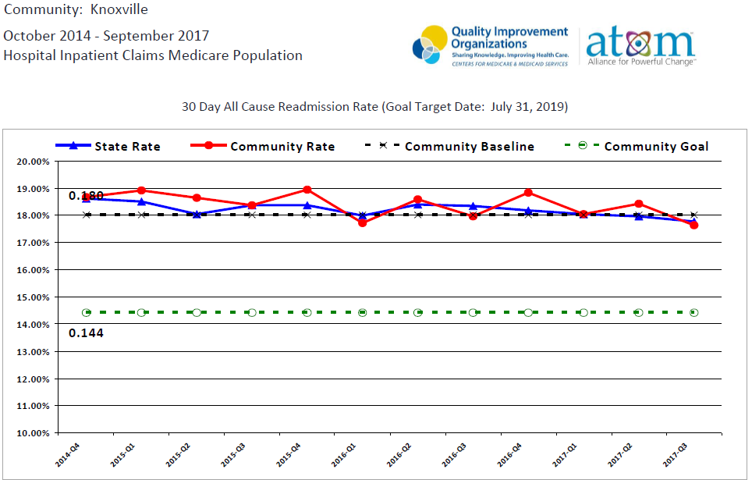
Readmissions in 30 Days Quarterly

Slide 3
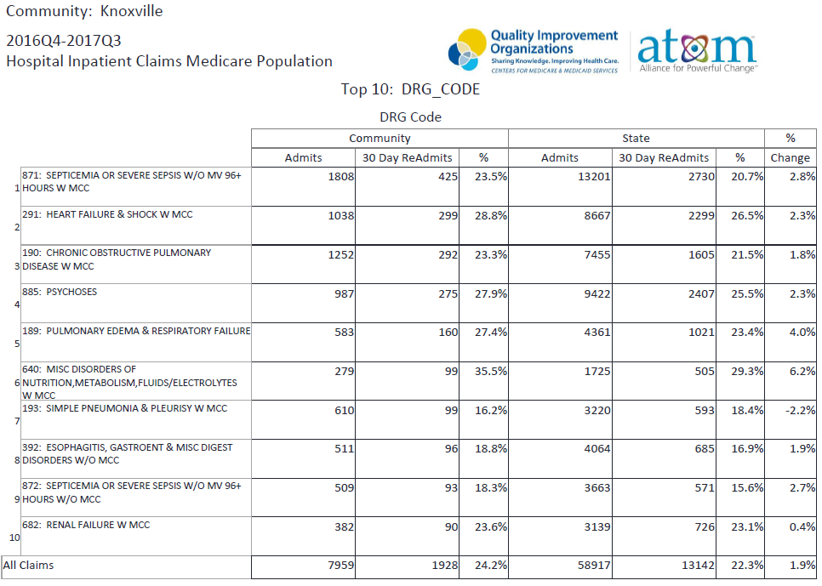
30 day Readmissions

Slide 4
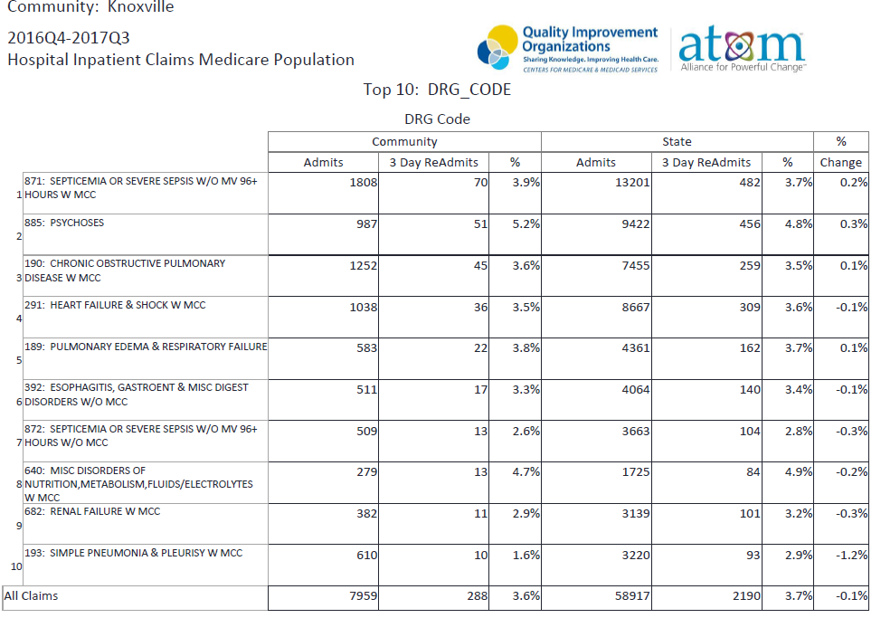
3 day Readmissions

Slide 5
Sepsis Readmissions Summit
https://www.cvent.com/c/express/e5622c03-2224-4738-b73f-eaa0fd366d2c

Slide 6
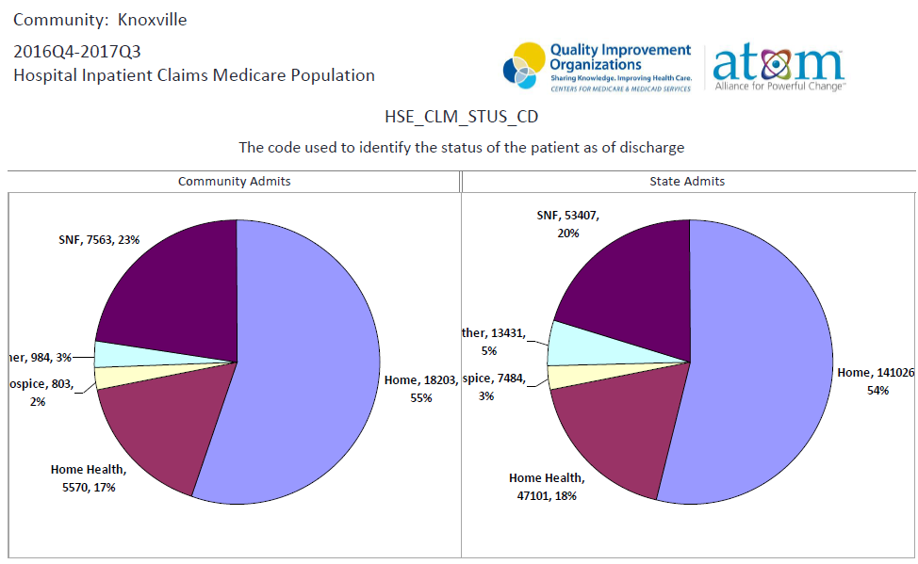
Discharge Disposition

Slide 7
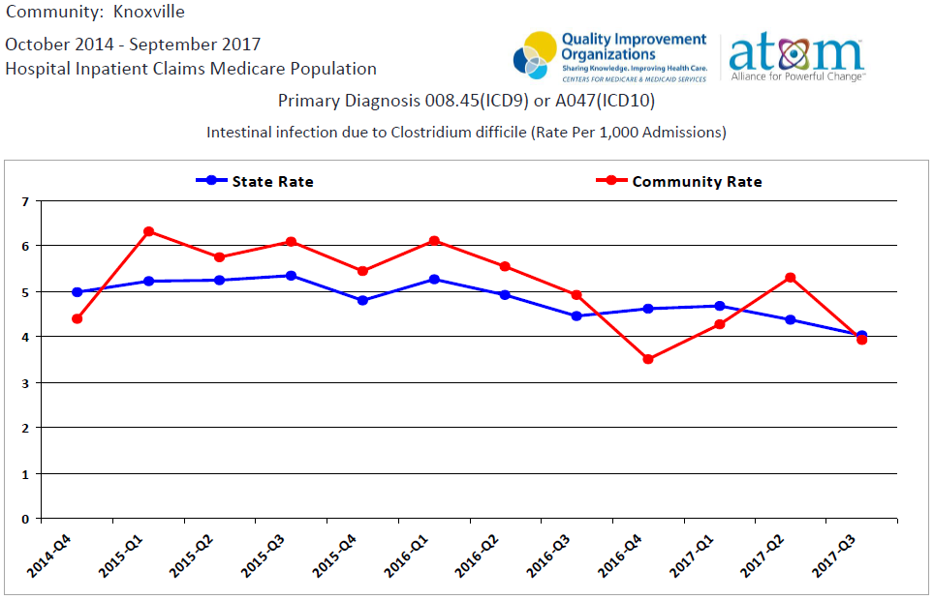
C Diff (Clostridium difficile)

Slide 8
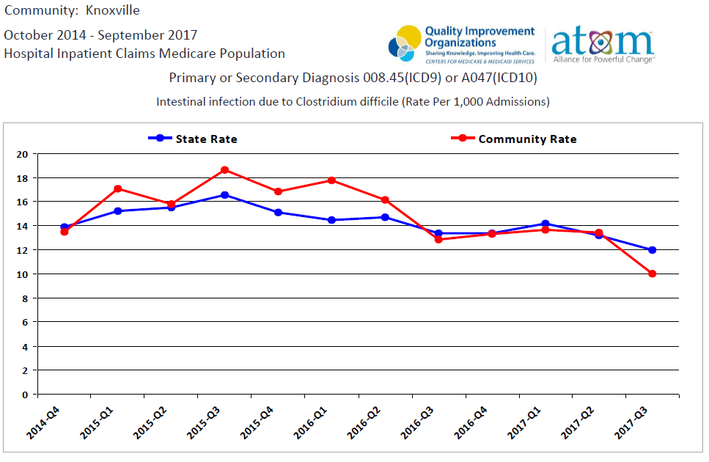
C Diff (Clostridium difficile)

Slide 9
C Diff : Prevention is Key
C Diff contagious infections are caused by a bacteria carried in the intestine
C Diff Infection often activated by antibiotics taken to treat other illness
Often the hand picks up C Diff from a surface that has minute amounts of fecal waste. The bacteria can then find it’s way into the mouth via touch, food etc
Community onset considered day 1-3
Facility onset considered day 4 >

Slide 10
C Diff : Measurement
Measured by SIR (Standard Infection Ratio) (HAI – Hospital Acquired Infection)
SIR = Observed/Predicted
SIR = 1 Same HAIs as predicted by US baseline data
SIR > 1 More HAIs than predicted
SIR < 1 Fewer HAIs than predicted
HHS 2020 Goal for CDI is SIR = 0.70
CDI in Acute Care Facilities
Year | # of Facs | TN SIR | # Low SIR | # High SIR
2015 | 108 | 0.97 | 11 | 8
2016 | 108 | 0.88 | 23 | 11
2017 | 106 | 0.84 | 29 | 6
Source: Marion Kainer, MD, MPH, Director Healthcare Associated Infections and Antimicrobial Infections, TDOH.
Presented at TCPS Regional Networking Meetings April 2018

Slide 11
C Diff : Knoxville area Outbreak (TDOH)
Hospitals should implement and monitor compliance with basic infection prevention practices to address infections:
Hand hygiene
Environmental cleaning
Isolation precautions
Correct use of personal protective equipment
Nursing Homes expected to have infection prevention in performance plans as well as trained staff by 2019
http://www.cdc.gov/nhsn/ps-analysis-resources/references-guides.html

Slide 12
Thank You for your contribution and commitment to the mission and don’t forget to wash your hands! Presented April 26, 2018

